Slide 1


ECG Filtering
Rensselaer Polytechnic Institute

Slide 2
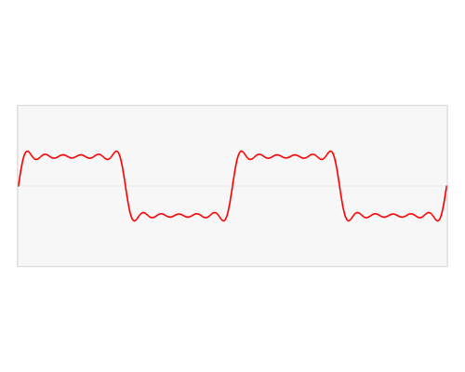
Awesome Fourier GIF

Slide 3
Make sure to open ‘readECG.m’

Slide 4
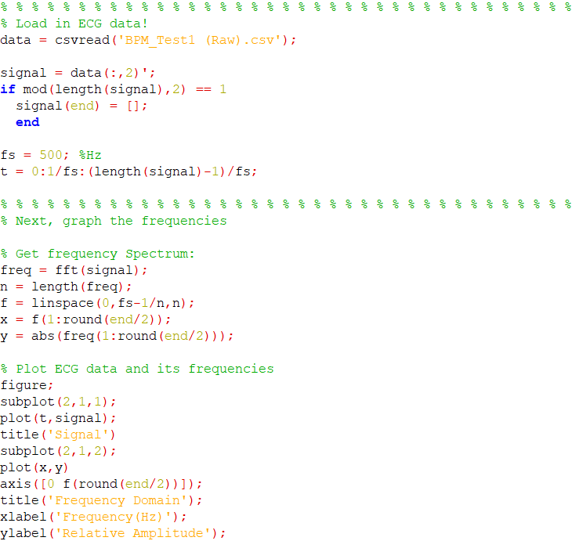

Slide 5
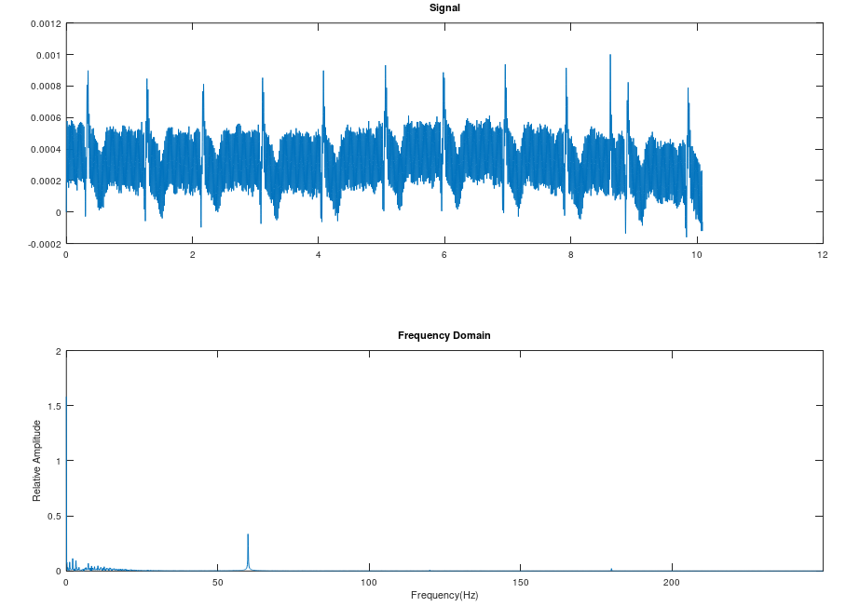

Slide 6
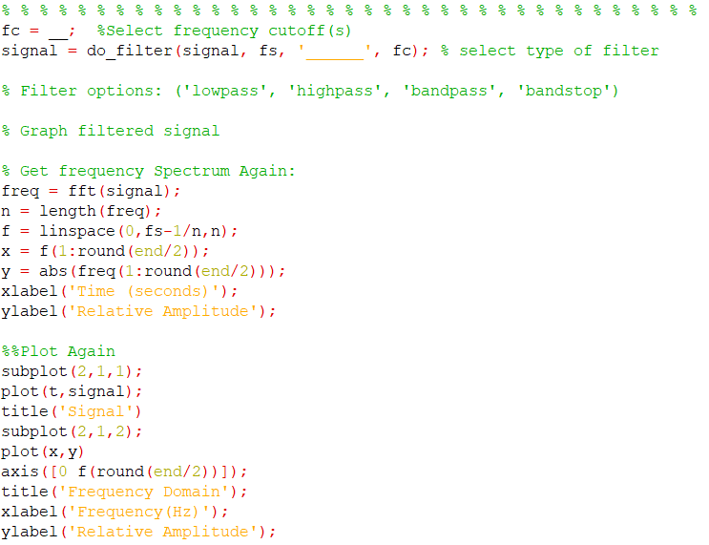

Slide 7
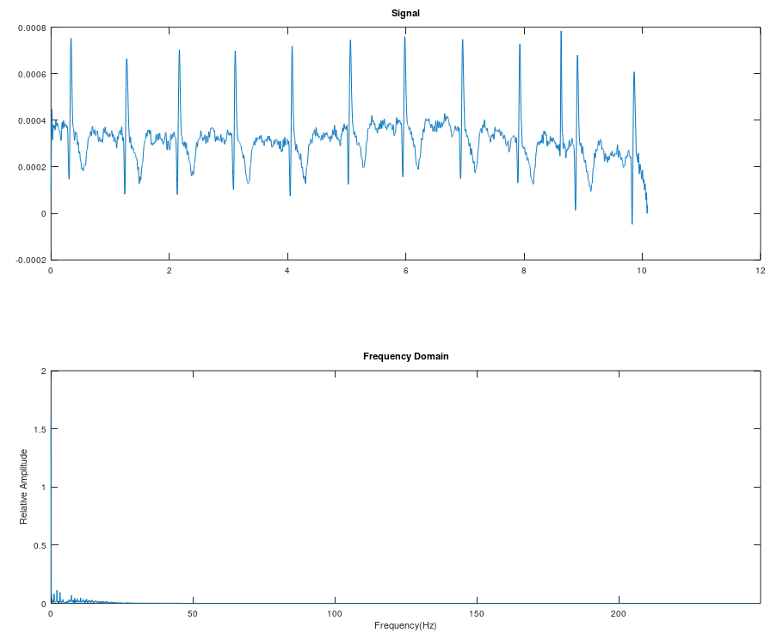
Example: Lowpass with fc = 45 Hz

Slide 8
DISCUSSION

